Slide 1
You’ve Got a Disaster Recovery Allocation What’s Next??
LaParry Howell, MPA Executive Director City of Tuscaloosa, AL Office of Community and Neighborhood Services
June 11, 2025

Slide 3
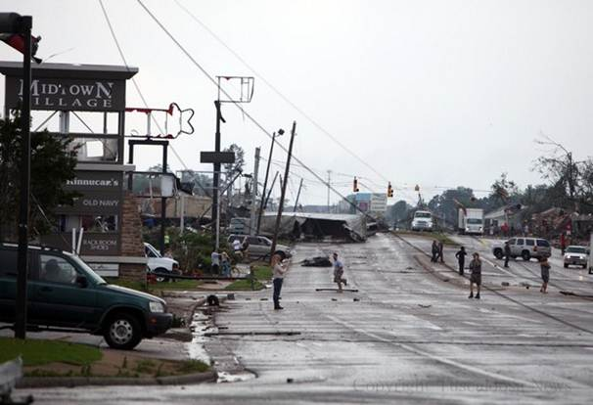
At 5:13 pm, an EF-4 tornado left a six-mile track of destruction through the City of Tuscaloosa.
Contact information here.

Slide 4
The mile-wide tornado took the lives of 52 citizens.

Slide 5
12% of our City was destroyed and 7,000 people became unemployed in less than six minutes.

Slide 6
More than 1,200 injured and treated at DCH the night of the storm.

Slide 7
Residential, Commercial, & City Infrastructure Damages Over 600 businesses damaged Residential damage 2,493 damaged 1,612 severely damaged 1,257 destroyed City Infrastructure Fire Station 4 East Police Precinct 2 Communication Towers

Slide 8
Areas of Focus for Mayors
Preparedness and Organizational Structure*
Emergency Response
Media and Communications
Humanitarian Efforts
Debris Removal
Collaboration with Federal, State and Local Agencies*
All City Departments Required
Preparing for the Future*

Slide 9
Preparedness and Organizational Structure

Slide 10
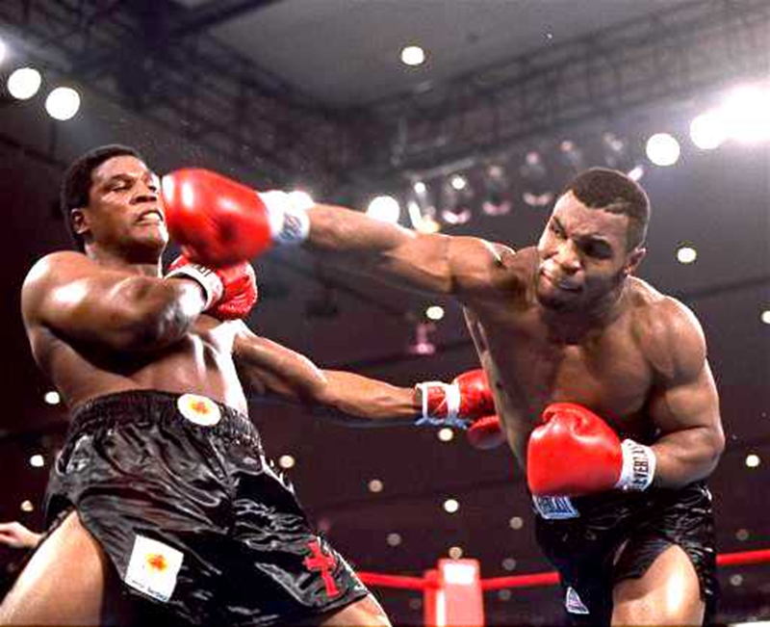
Over 600 businesses damaged Residential damage 2,493 damaged 1,612 severely damaged 1,257 destroyed City Infrastructure Fire Station 4 East Police Precinct 2 Communication Towers

Slide 11
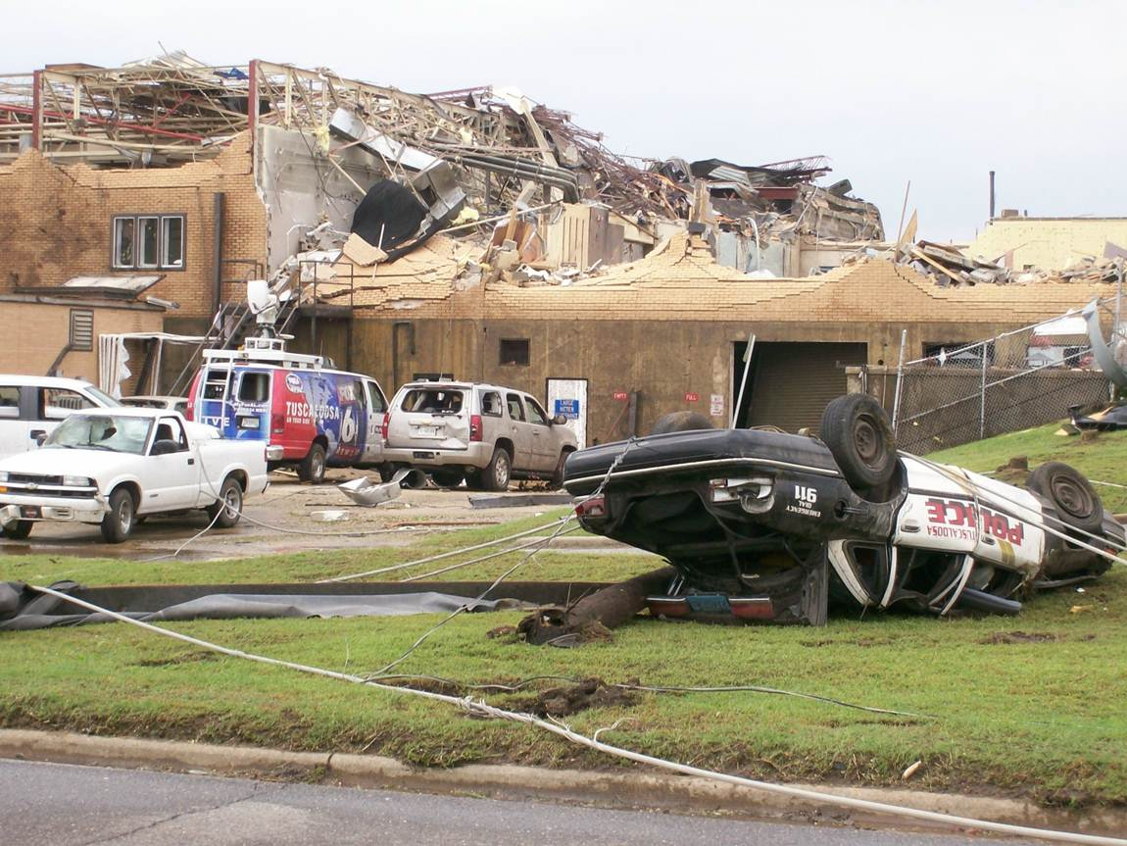
City of Tuscaloosa, AL Disaster Recovery Allocation DR1: $16,634,702.00 DR2: $43,932,000.00

Slide 12
Incident Commanders
City Departments
GIS
Finance
City Council
Logistics
Recovery Coordinators
Volunteers
Foundation
Housing
Grants
Mayor
Media
Operational Teams

Slide 13
Operational Teams
Debris Removal
Persons of Concern
Facilities
Infrastructure
Short Term Recovery
Facilities
Finance
Logistics/
Purchasing
Humanitarian Services
Search and Rescue

Slide 14
Collaboration with Federal, State and Local Agencies

Slide 15
FEMA
Strengths
Mobilized quickly and integrated into our command structure
Provided disaster relief centers and assistance to citizens within 96 hours of the event
Coordinated and funded Operation Clean Sweep
Dedicated individuals with a great deal of knowledge

Slide 16
FEMA
Weaknesses
Rotate personnel constantly
At times, only provides information upon request or withholds vital information
Organizational structure prohibits local decision-making and confusion within the ranks
Over promise and under-deliver
Requests are often sent into a black-hole
Not well-positioned for long-term recovery or interaction with HUD

Slide 17
HUD
Strengths
Dedicated Personnel
Appropriate vehicle for housing issues
Secretary Donovan is engaged
Weaknesses
Does not interact with FEMA
Congressional appropriations for CDBG and other HUD programs are inadequate

Slide 18
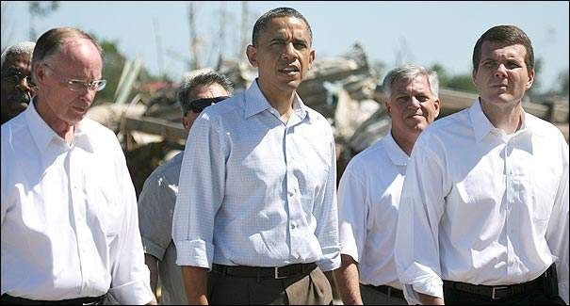
White House and Congressional Delegation
Strengths
Presidential Visit
Long-time relationship with Delegation
Members serving in key positions
Weaknesses
Democratic Administration and Republican Delegation
Broke Recovery

Slide 19
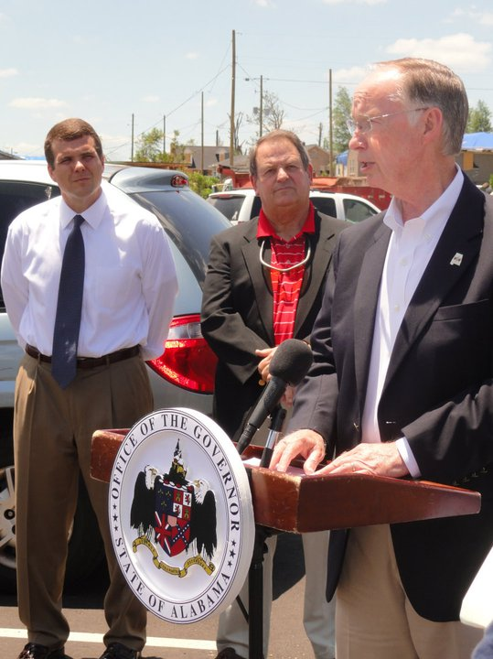
Governor, State Legislature and AEMA
Strengths
Personal relationship with the Governor
Provided resources immediately
Governor allowed the City to managed the disaster
Daily briefings of local legislative delegation
Provided a strong cost share in debris removal
Weaknesses
43 Counties were impacted in Alabama
State government not positioned for long-term recovery

Slide 20
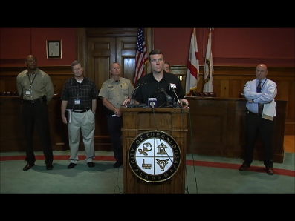
LOCAL
Strengths
Citizens and businesses led the way
34 municipalities participated in emergency response
City and county conducted unified media briefings
Majority of damage occurred in City’s Police and Fire jurisdiction
University of Alabama
Weakness
Overwhelmed with offers to provide resources
Tuscaloosa County EMA was destroyed
Political issues

Slide 21
Preparing for the FUTURE

Slide 22
Timing is Everything

Slide 23
Build Back Now or Build Back Better?
The Tuscaloosa Forward Strategic Rebuilding Plan will establish the community’s vision for the future of Tuscaloosa

Slide 24
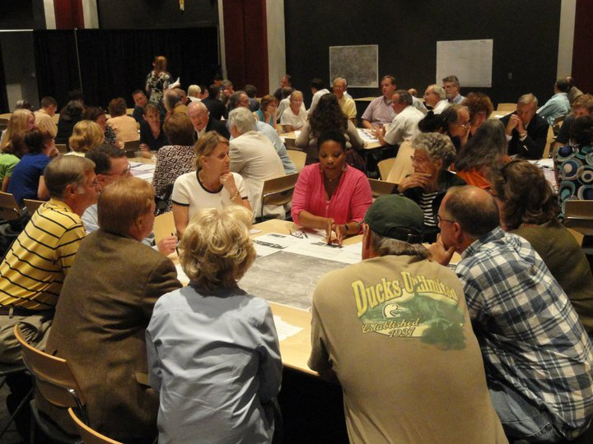
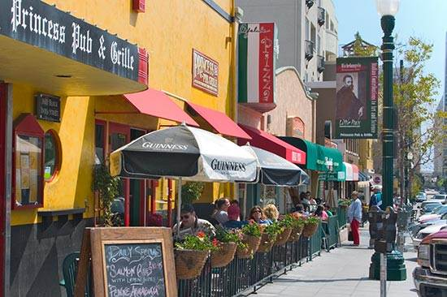
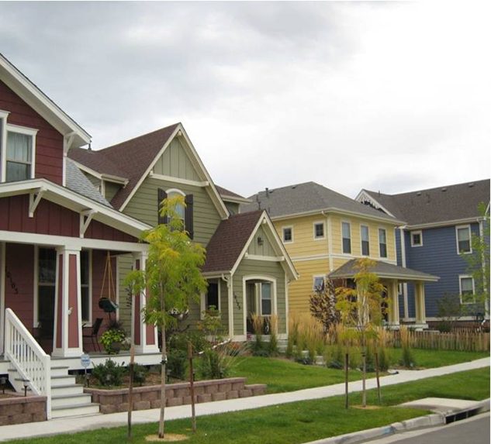
Build Back Now or Build Back Better?

Slide 25
Managing the Recovery Housing Infrastructure Building Codes and Zoning Floodways Financial Impact Federal Funding Humanitarian Efforts Staffing Psychological Impact

Slide 26
Out of Chaos Comes Hope

Slide 27
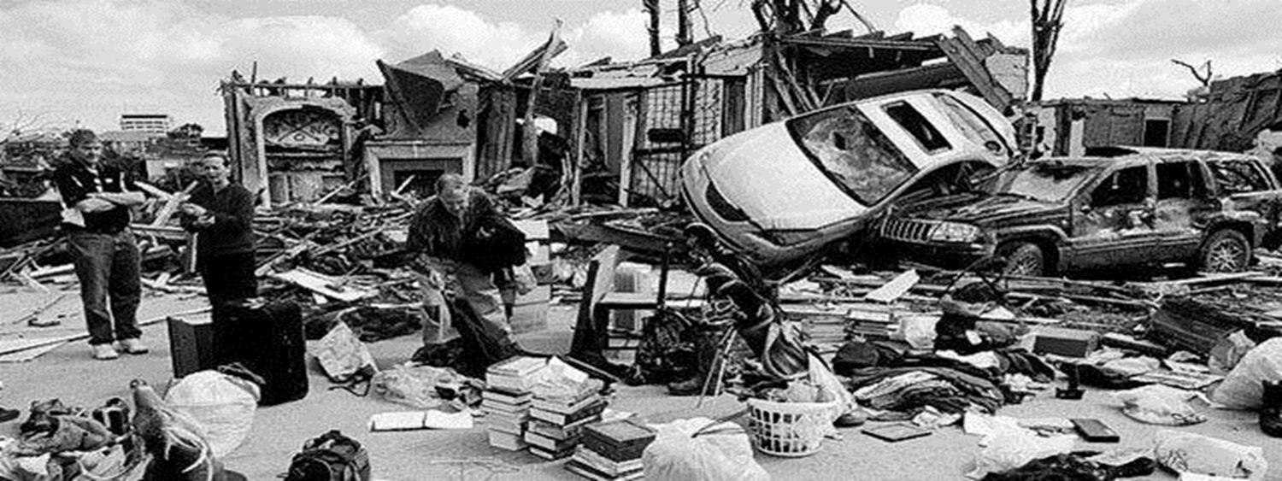
THANK YOU!!!!!

